Slide 1
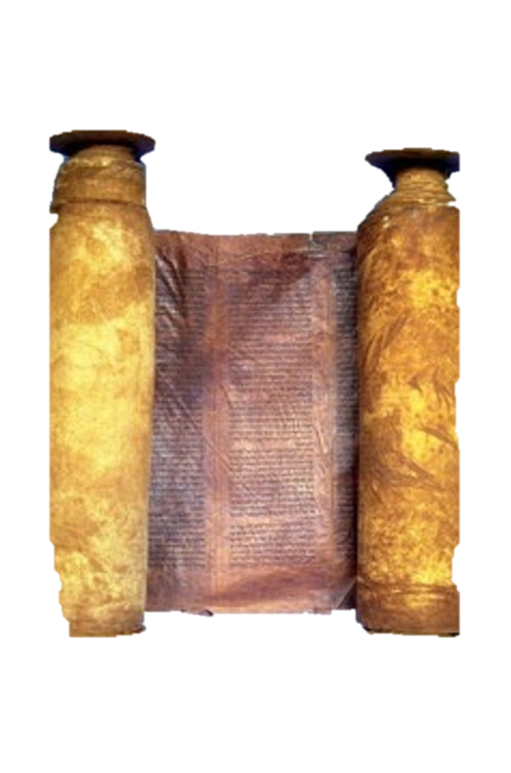
A free CD of this message will be available immediately following the service
2 Kings
17-19
A podcast will also be available later this week at calvaryokc.com

Slide 2
Israel
Judah
Pekah, 740-732
Jotham, 739-735
Hoshea, 732-722
Ahaz, 735-715
2 kings 17-19

Slide 3
2 kings 17-19

Slide 4
Israel
Jerusalem
Philistia
Judah
2 kings 17-19

Slide 5
2 kings 17-19

Slide 6
NASB ~ And they followed vanity and became vain …
Better, they followed emptiness and became empty
2 kings 17-19

Slide 7
2 kings 17-19

Slide 8
Hezekiah ~ Yahweh is my strength
2 kings 17-19

Slide 9
Israel
Judah
Pekah, 740-732
Jotham, 739-735
Hoshea, 732-722
Ahaz, 735-715
Hezekiah, 715-686
2 kings 17-19

Slide 10
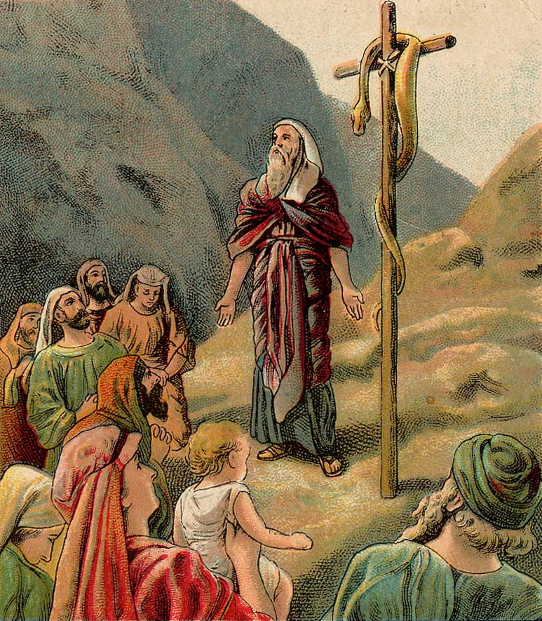
Nehushtan ~ that brass thing
1400 BC
1200 BC
1000 BC
800 BC
Years of Wandering
700 years
2 kings 17-19

Slide 11
2 kings 17-19

Slide 12
Held fast ~ dabaq
Gen. 2:24 ~ Therefore a man shall leave his father and mother and be joined to his wife, and they shall become one flesh.
2 kings 17-19

Slide 13
2 kings 17-19

Slide 14
NIV ~ his supreme commander, his chief officer and his field commander …
2 kings 17-19

Slide 15
2 kings 17-19

Slide 16
KJV, blast
Ruach - wind, breath or spirit
2 kings 17-19

Slide 17
2 kings 17-19

Slide 18
60s
PrayerChangesThings
Prayer Doesn’t Change
Things … It Changes People
70s
Prayer Doesn’t Change Things
It Changes People
People Change Things
80s
2 kings 17-19

Slide 19
2 kings 17-19

